Slide 1
Introduction to JWST data
With focus on transiting exoplanets

Slide 2
Content
Definitions: ramps, groups (frames), integrations, exposures
jwst pipeline
Group-level noise
JWST instruments and modes
Introducing each target data set

Slide 3
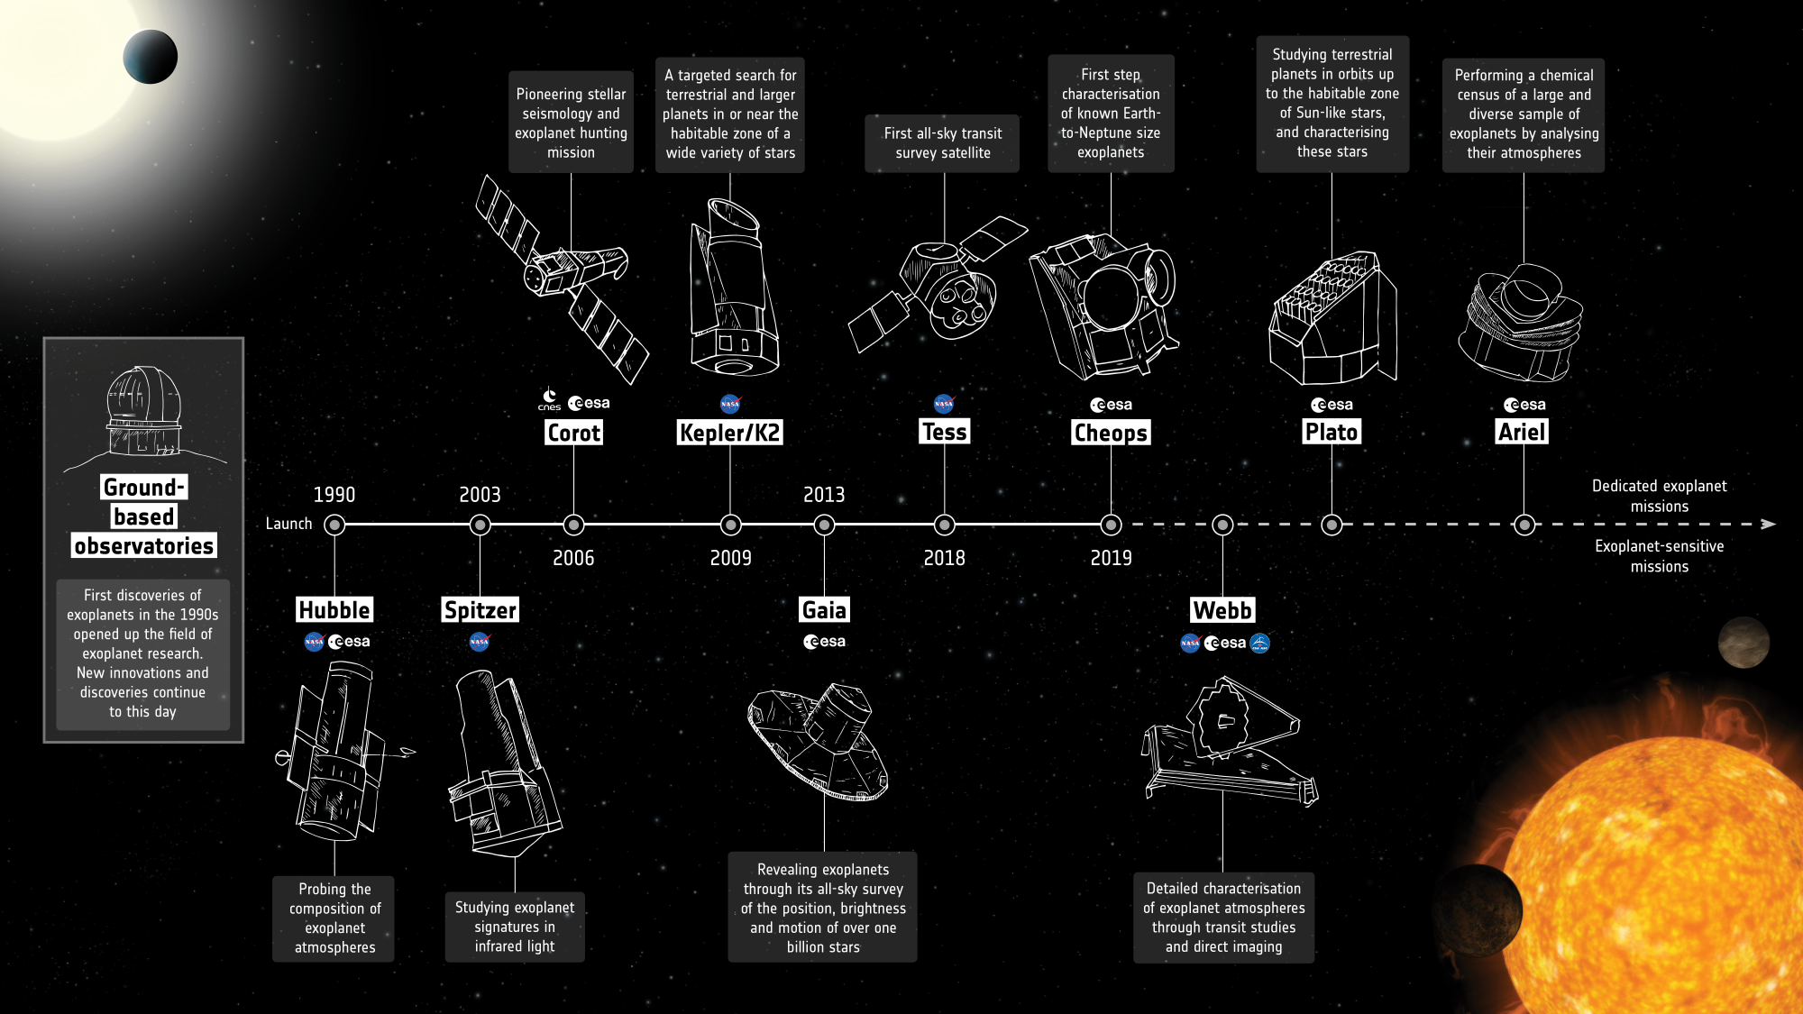
Credit:
ESA

Slide 4
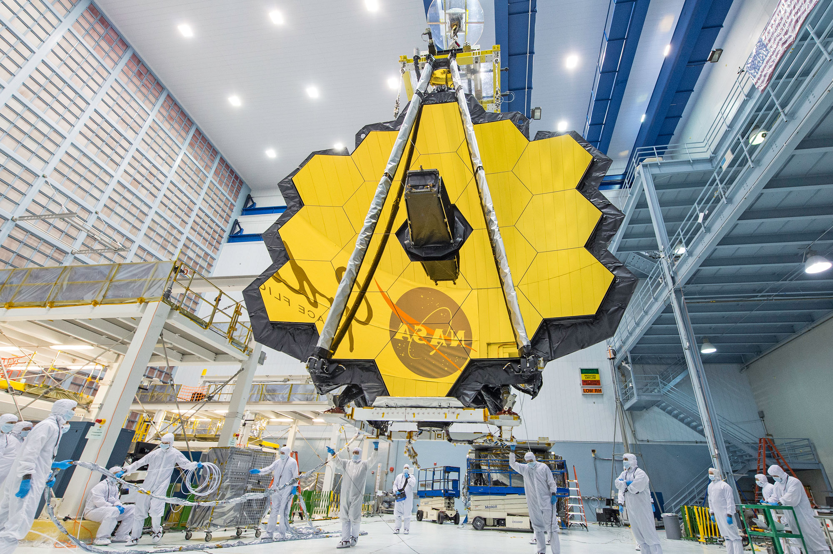
JWST
Launch: Dec 25, 2021
Beginning of science: Summer 2022
Location: L2
6.5m main mirror
Lifetime: Max. 20+ years
Credit: NASA

Slide 5
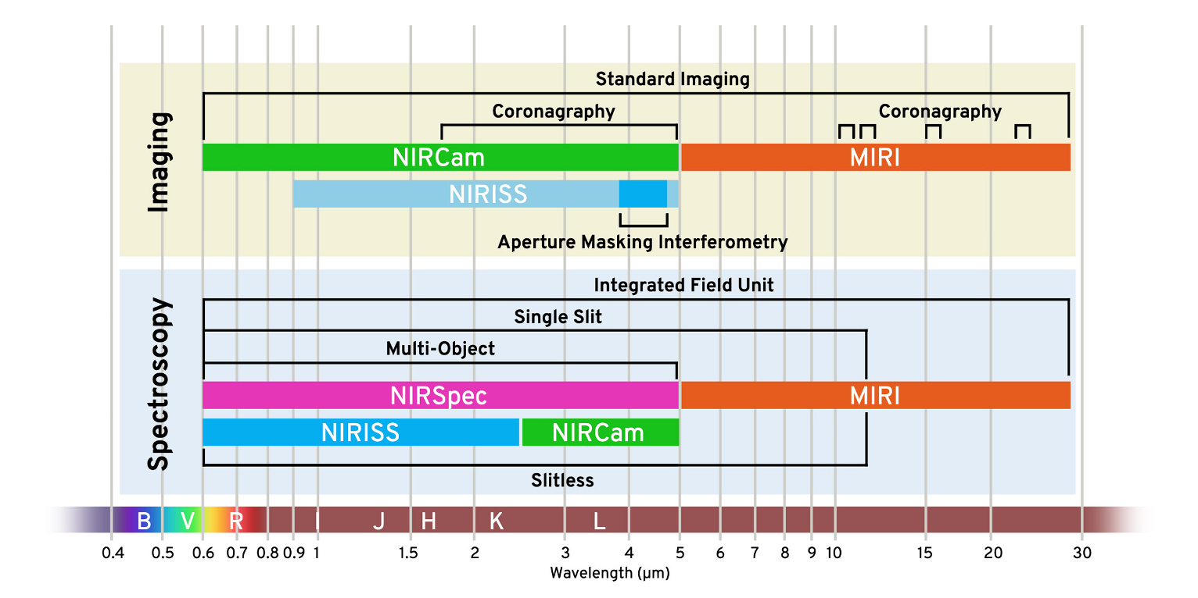
Instruments and modes
4 instruments: NIRISS | NIRCam | NIRSpec | MIRI
Credit: STScI

Slide 6
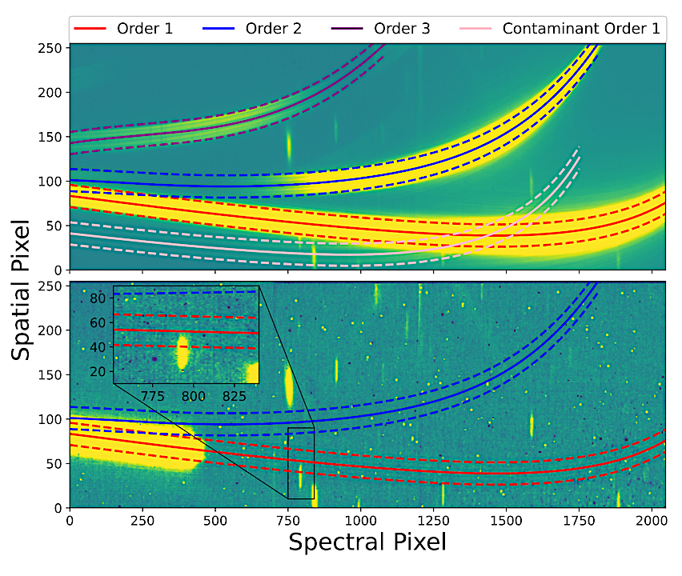
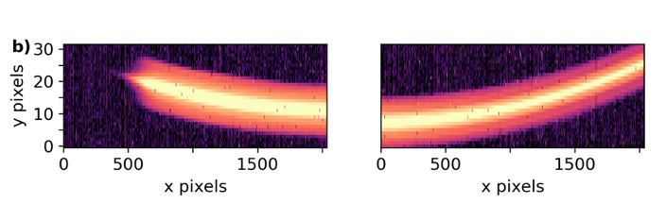
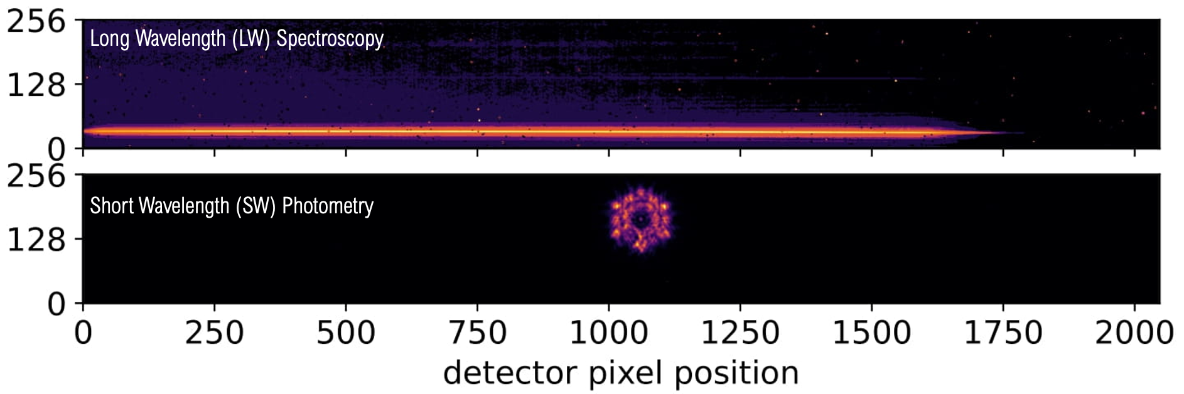
Example science images
NIRSpec/G395H, Alderson et al. 2023
NIRISS/SOSS, Radica et al. 2023
Top: median science frame with orders highlighted
Bottom: pre-image with a filter to see the contaminants and identify the contaminant’s oder that might overlap
NIRCam/F322W2, Ahrer et al. 2023: Two channels: SW photometry and LW spectroscopy

Slide 7
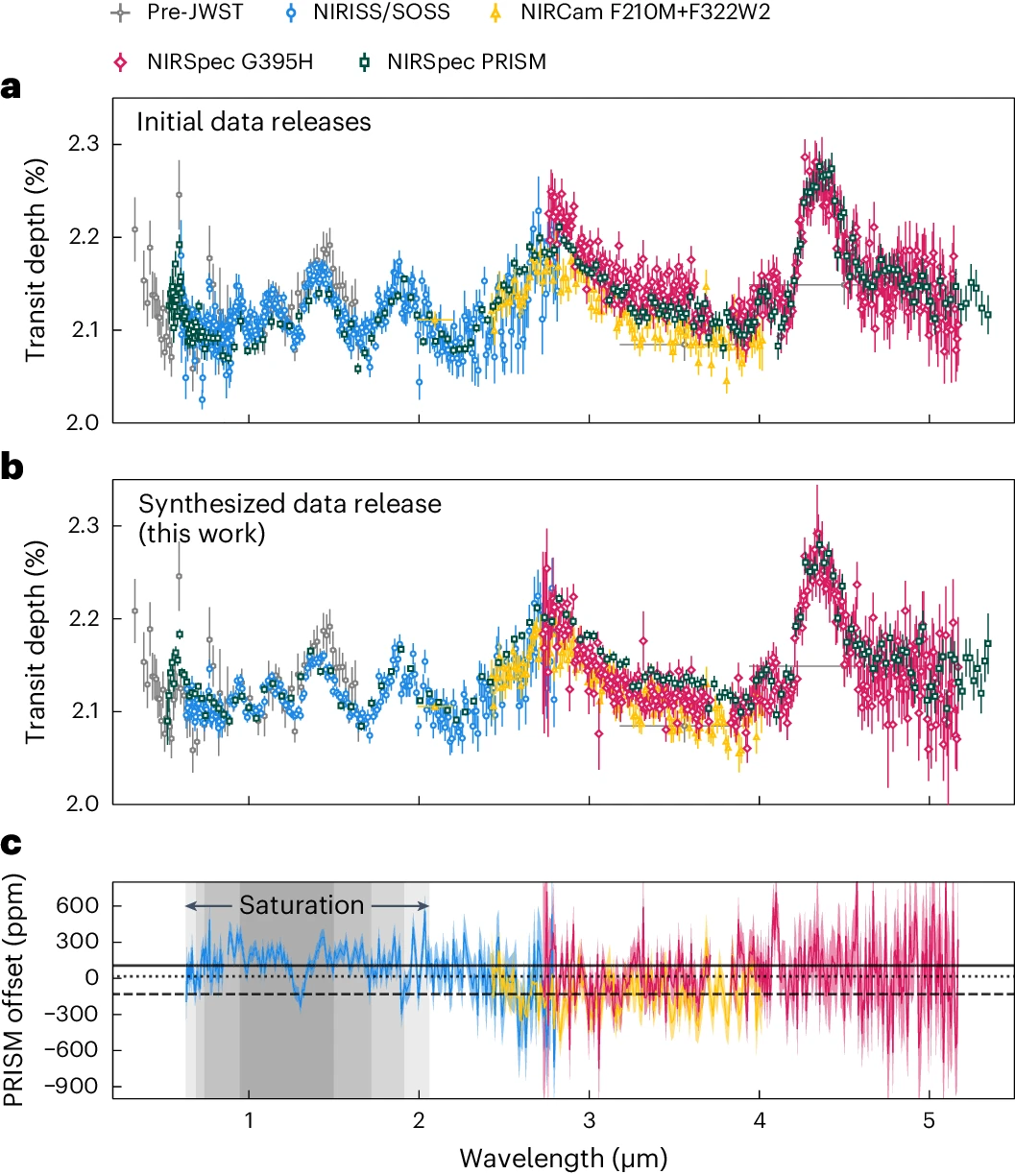
Instruments and modes: near-infrared
4 instruments: NIRISS | NIRCam | NIRSpec | MIRI
Most used modes
From Carter & May et al. 2024

Slide 8
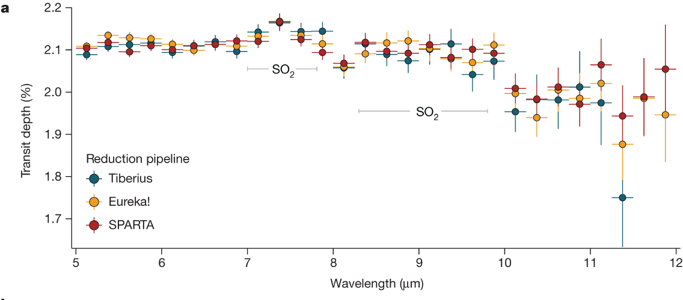
Instruments and modes: mid-infrared
4 instruments: NIRISS | NIRCam | NIRSpec | MIRI
Powell et al. 2024

Slide 9
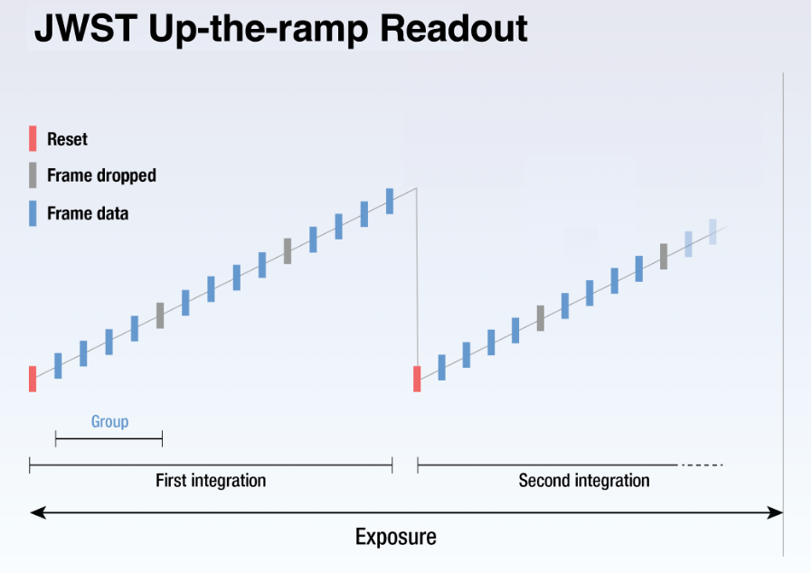
JWST observation
language
The jwst pipeline provides the conversion from frame to groups to integration
You’ll receive the integration-level reduced spectra (1D spectra)
from https://jwst-docs.stsci.edu/

Slide 10
(Un)calibrated JWST frames
Sidenote: The fits files have a maximum file size, so after they are also usually split into multiple segments.
*uncal.fits: uncalibrated 2D spectra at group level, i.e. data has 4 dimensions: dispersion-direction, spatial direction, integrations and groups
*calints.fits: calibrated 2D spectra for each integration (3 dimensions: spatial, dispersion and integrations)
Spectral extraction is then similar to ground-based, e.g., subtracting the background, fitting a trace, extracting the spectrum using a standard or optimal extraction, etc. → use your favourite pipeline or write your own ;)
May include steps between to reduce group-level noise
run jwst pipeline stages 1 & 2 (can also be another pipeline wrapped around the jwst pipeline e.g. Eureka!)

Slide 11
A note on group-level corrections
1/f noise is correlated readout noise (column-wise and row-direction): Best way is to conduct background subtraction before ramp-fitting (at *uncal.fits level)
Bias level: scaling may cause/correct a detector offset
Background scaling: background model from STScI of NIRISS/SOSS is not perfect
Issues with readout noise (390Hz), shadow region, may require group-level corrections
Relevant for: all | NIRISS | NIRCam | NIRSpec | MIRI

Slide 12
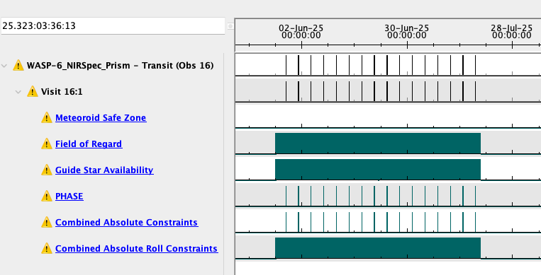
How to get your own JWST data
Yearly GO proposal cycle (deadline in October): Anyone can propose new observations!
Proposals are grouped by size: Very small (<20h), Small (<50h), Medium (<130h), Large
Astronomers Proposal Tool (APT): Observation planning

Slide 13
Introducing the JWST data sets
(ignore if you don’t want spoilers)

Slide 14
WASP-39b - a hot gas giant
The most studied exoplanet with JWST due to the Early Release Science Transiting Exoplanet Community program (ID: 1366, PI: N. Batalha, K. Stevenson, J. Bean).
Five transits available: NIRSpec/PRISM, NIRSpec/G395H, NIRCam/F322W2, NIRISS/SOSS and MIRI/LRS
WASP-39 is G7 type, quiet star
Period of 4.0553 days (Fischer et al. 2016)
Equilibrium temperature 1160 K (Mancini et al. 2018)
Pre-JWST observations showed features (e.g., see Wakeford et al. 2018)

Slide 15
WASP-39b - Resulting transmission spectra
Github: All data and figures from Carter & May et al. 2024
Initial data releases:
Ahrer et al. 2023, Alderson et al. 2023, Feinstein et al. 2023, Rustamkulov et al. 2023
+ there’s MIRI/LRS, all 3 reductions from Powell et al. 2024

Slide 16
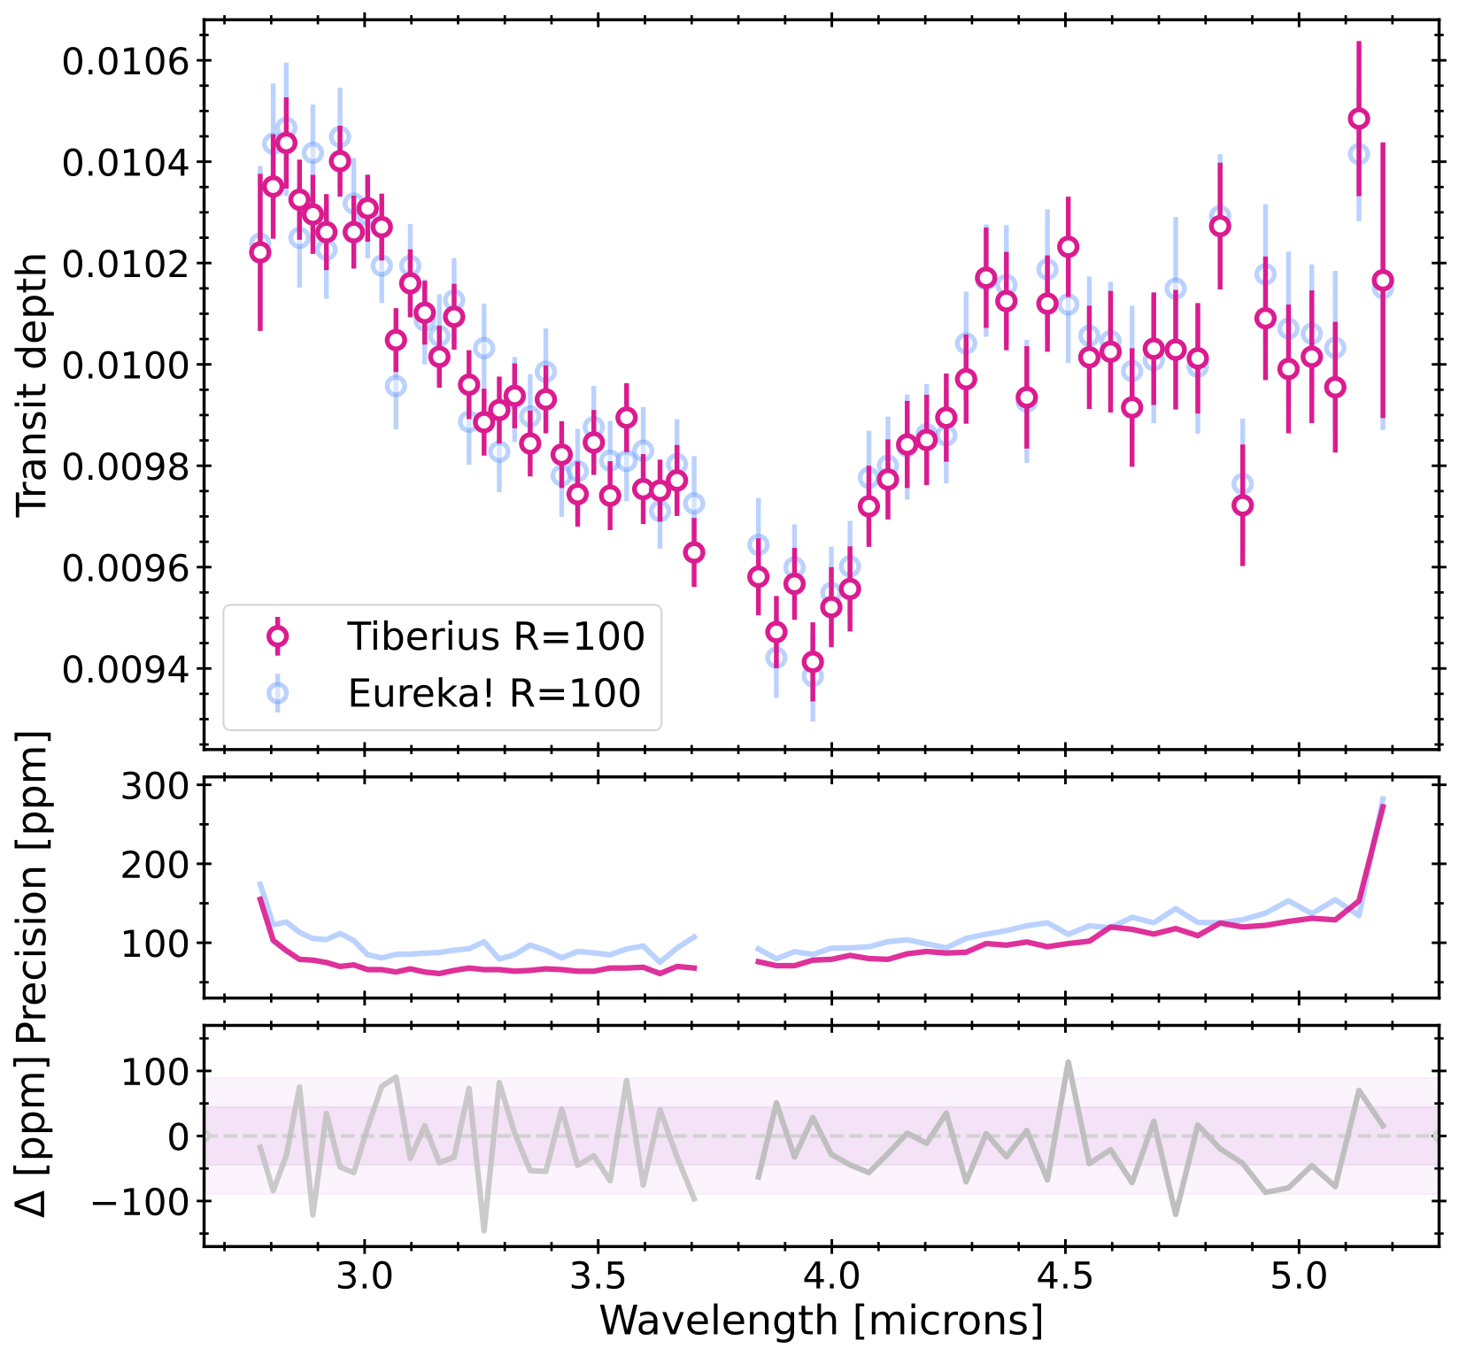
TrES-4b - another hot gas giant
From Meech et al. 2025
Github: Tiberius spectra and Eureka! typical output after spectral extractions
Planet and stellar parameters: https://exoplanetarchive.ipac.caltech.edu/overview/TrES-4

Slide 17
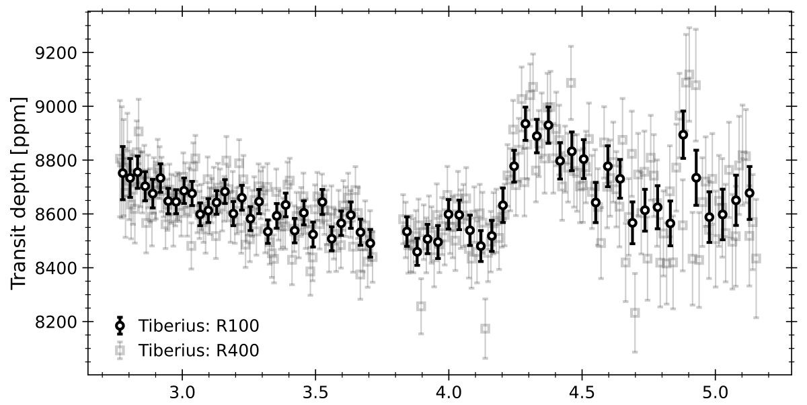
WASP-15b - and another hot gas giant
From Kirk et al. 2025
Github: Tiberius spectrum
Planet and stellar parameters: https://exoplanetarchive.ipac.caltech.edu/overview/WASP-15

Slide 18
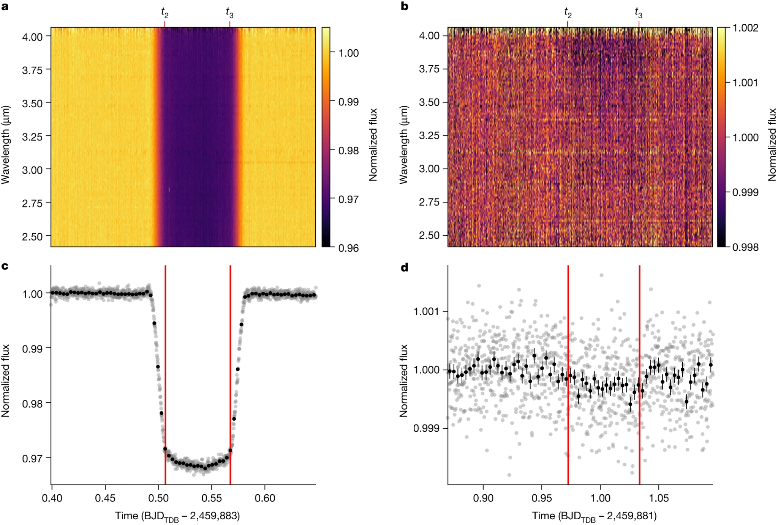
WASP-80b - a warm/hot gas giant (~800 K)
From Bell et al. 2023:
Github: stellar spectra from paper, for both emission and transmission
Planet and stellar parameters: https://exoplanetarchive.ipac.caltech.edu/overview/WASP-80

Slide 19
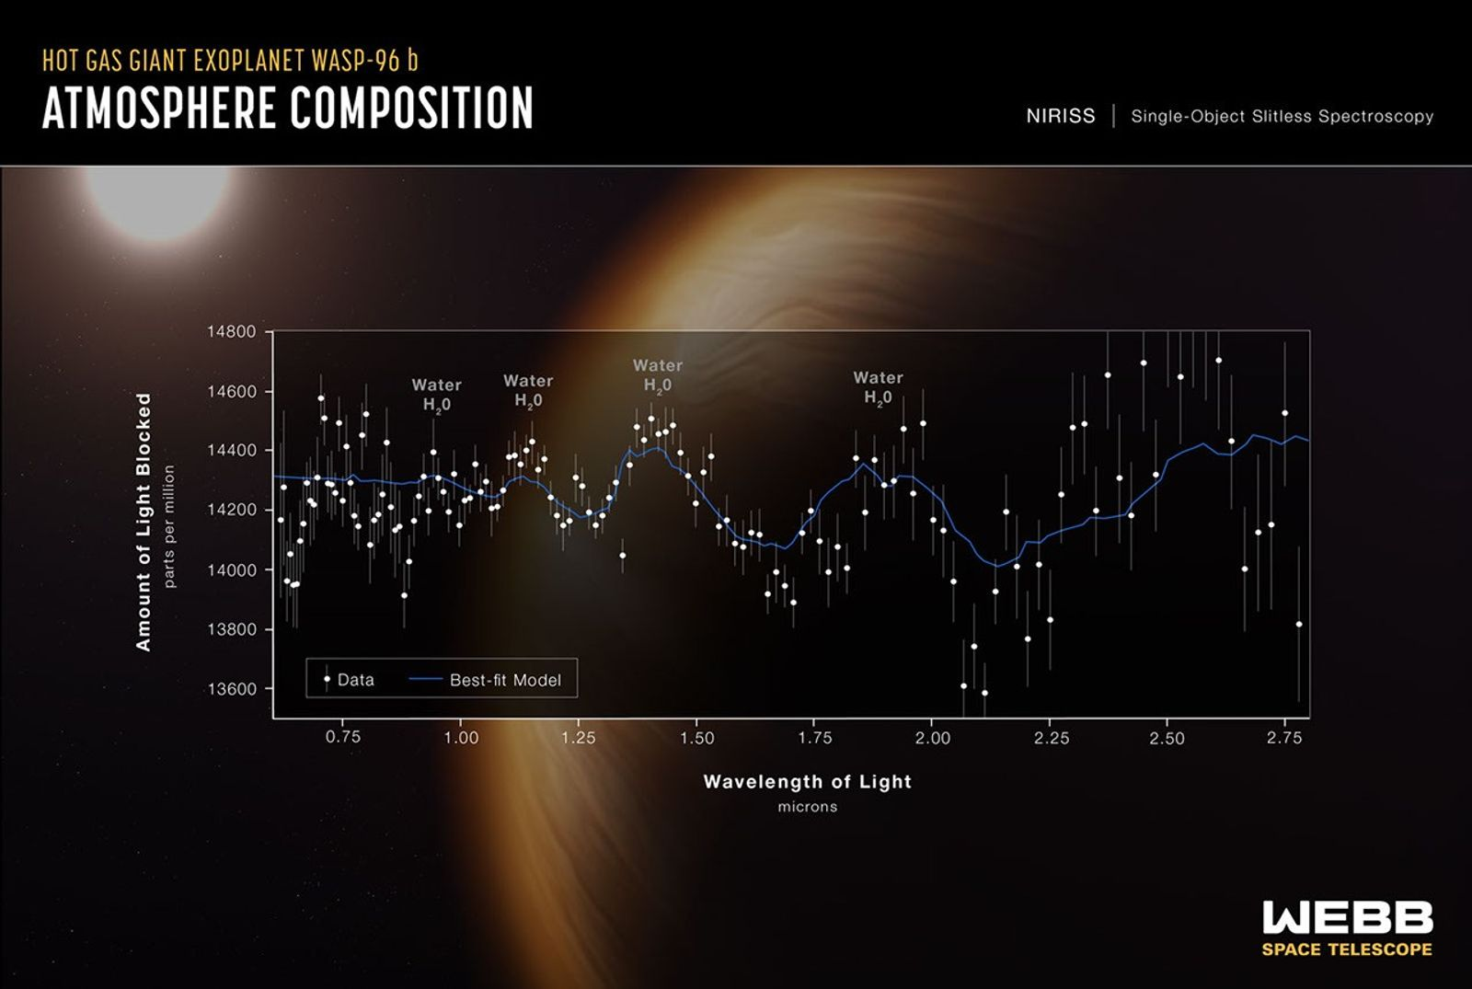
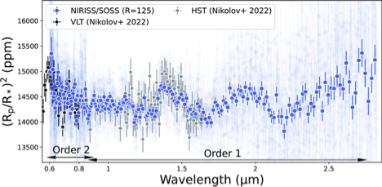
WASP-96b - the ERO target
From Radica et al. 2023;
using the data set that was part of the Early Release Observations (the first images of JWST in July 2022)
Github: stellar spectra from exoTEDRF reduction (former supreme-spoon), including the principal component analysis (PCA) components that can be used for light curve detrending

